Slide 2
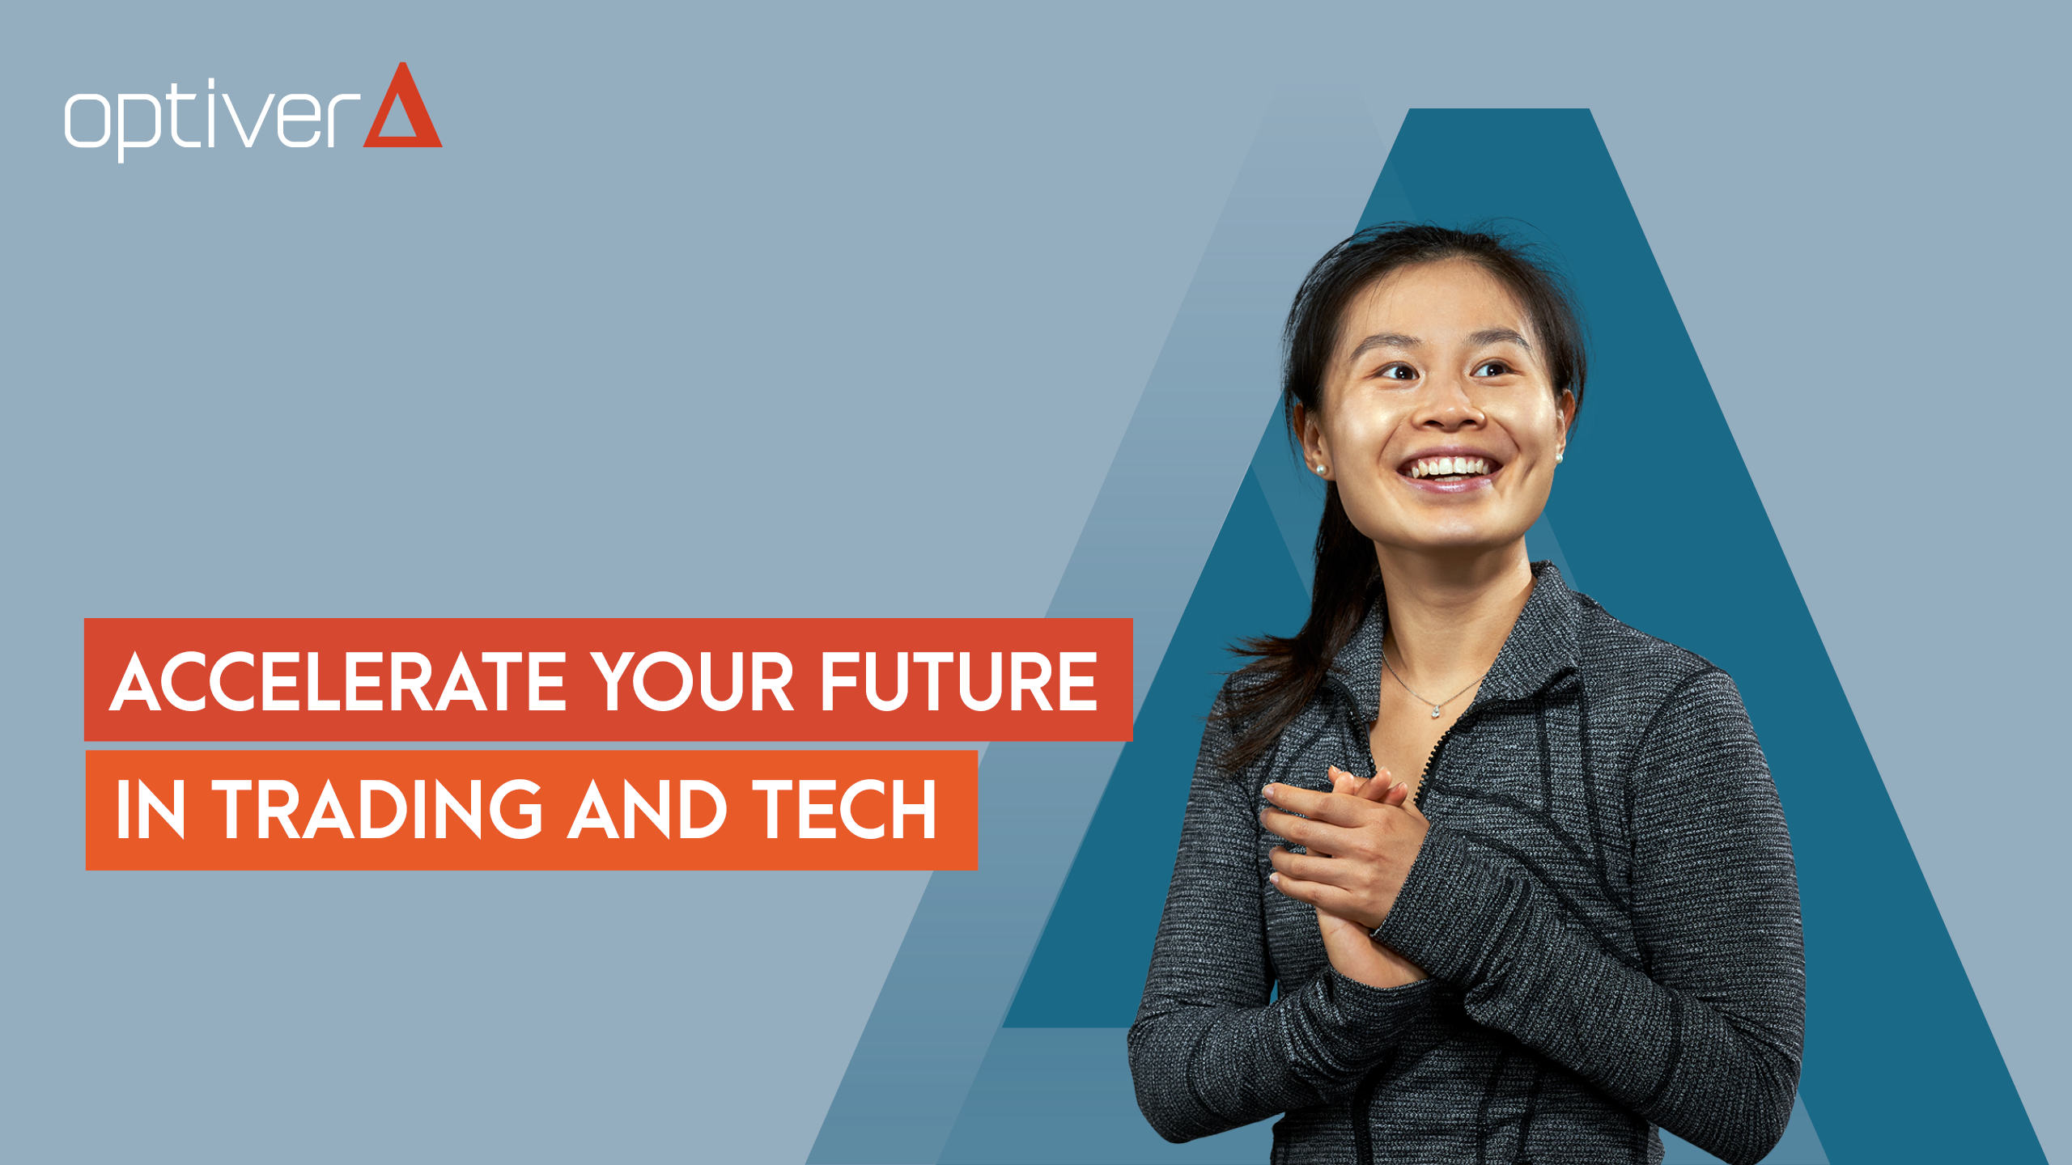
MELBOURNE HACK 2022
BUILDING A TRADING BOT WITH OPTIVER

Slide 3
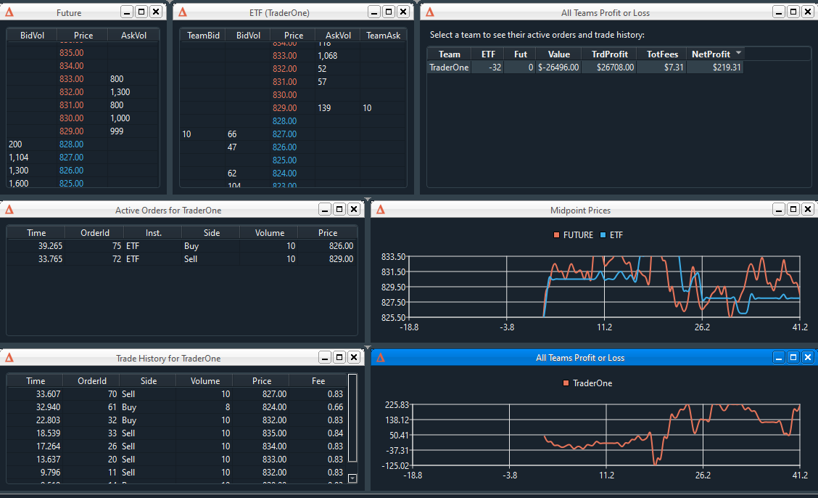
Agenda
Trading Basics
The Pillars of HFT
What is Market Making?
What is a Theo? How can we calculate one?
Risk Basics
Execution Basics
Making a Basic Autotrader
Explaining the UI (Future vs ETF, Profits)
Building a trader using what we just learnt
Further reading to make a better auto-trader

Slide 4
The basics

Slide 5
Pillars of Trading
The heart of Optiver’s Business
Pricing
Execution
Risk
Market Making
We will focus on these today

Slide 6
Pillars of Trading
The heart of Optiver’s Business
Pricing
Execution
Risk
Market Making
These are just as important, but we will only cover them briefly

Slide 7

Market Making – The basics
Pretend you wish to Sell a house…
Selling a house is painful
You need to find buyers
You need to negotiate with them all on a fair price
You close the deal months after listing
Houses, are illiquid (majority of cases)
Notes:
Image source: https://www.istockphoto.com/photos/house-for-sale

Slide 8
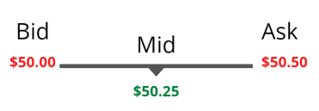
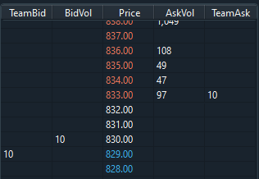
Market Making – The basics
Now think stocks
Imagine the same was for stocks
How on earth would we have a functioning and efficient global market?
Market makers like Optiver are always in the market to buy and sell stocks at a fair price
They profit on the bid-ask spread (and the exchange also pays them)
With the help of market makers, stocks are liquid
You don’t care what direction the market moves, you care about volatility
As a market maker, you want a relatively flat position, or to hedge out your positional risk.
Spread: 50 cents

Slide 9
Theo
The key to any auto-trader…
The fair price we think the instrument should trade at

Slide 10
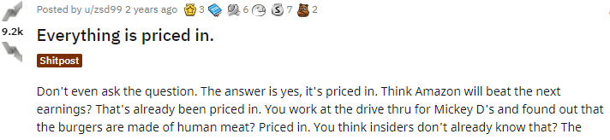
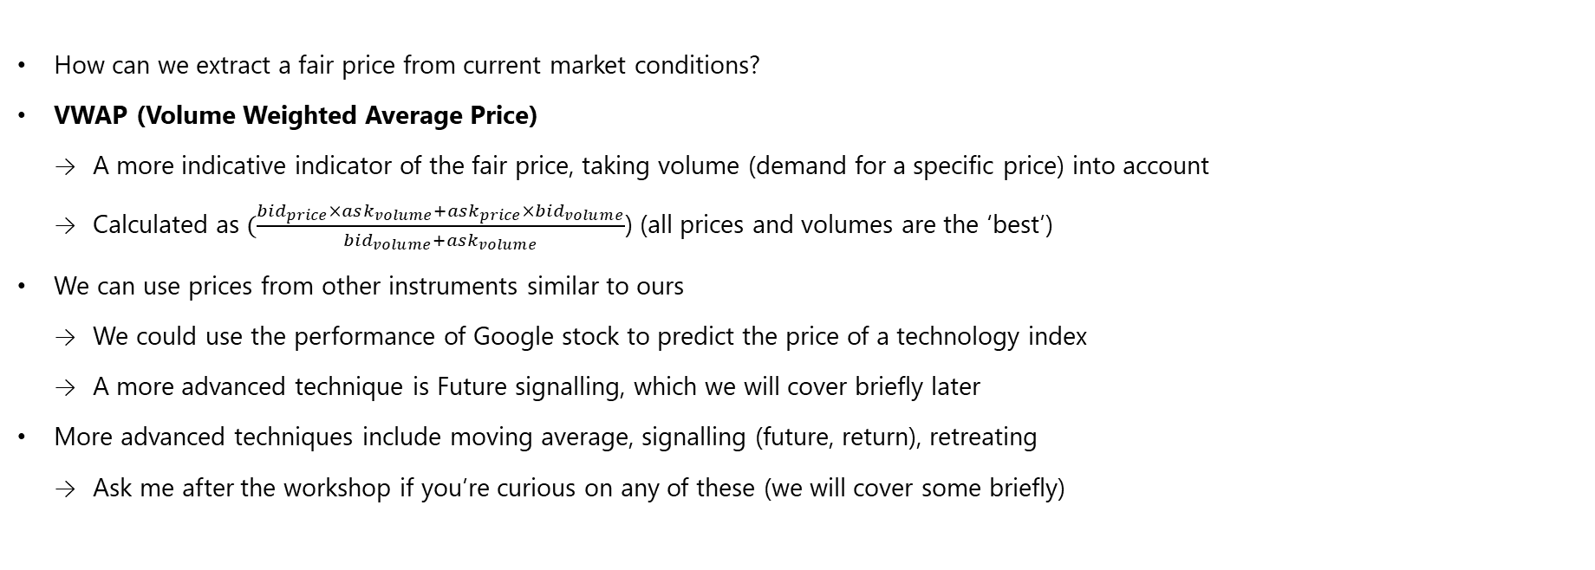
Pricing – the basics
How do we find this mysterious theo?
How can we extract a fair price from current market conditions?
VWAP (Volume Weighted Average Price)
A more indicative indicator of the fair price, taking volume (demand for a specific price) into account
Calculated as $(\frac{bid_{price}×ask_{volume}+ask_{price}×bid_{volume}}{bid_{volume}+ask_{volume}}$) (all prices and volumes are the ‘best’)
We can use prices from other instruments similar to ours
We could use the performance of Google stock to predict the price of a technology index
A more advanced technique is Future signalling, which we will cover briefly later
More advanced techniques include moving average, signalling (future, return), retreating
Ask me after the workshop if you’re curious on any of these (we will cover some briefly)
Notes:
Reddit source: https://www.reddit.com/r/wallstreetbets/comments/eberem/everything_is_priced_in/

Slide 11
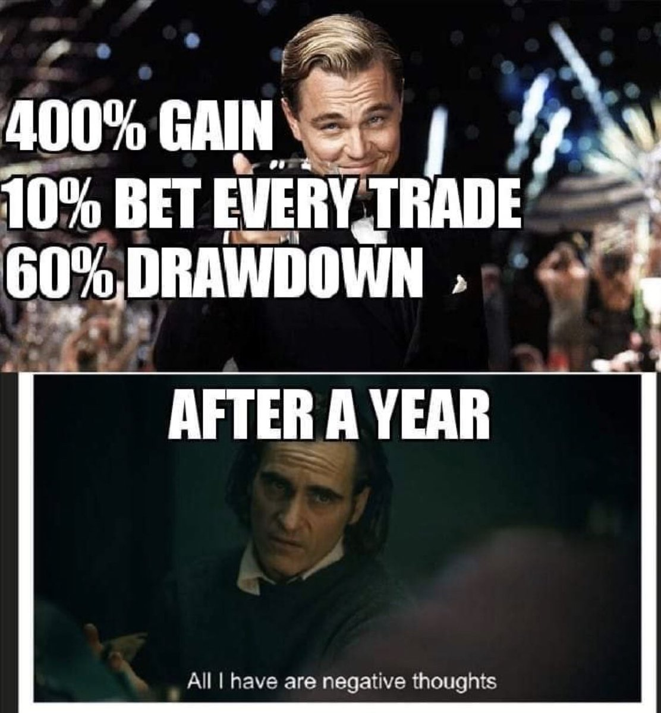
Quick Look at: Risk
Why care about risk?
Exchanges like most things in life have rules
You can’t just rock up and manipulate the price to what you want
Exchanges have the right to ban you if you do anything considered unfair
It’s important to make your trading strategy compliant
You also got to be careful with your money
Losing money isn’t fun
Decide on a risk appetite, and work off that
Hedge out risks you don’t want to take (hedging is like insurance for your position)

Slide 12
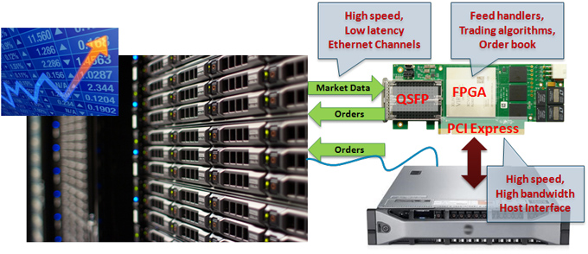
Quick Look at: Execution
It’s a game of speed
There are a lot of other participants all trying to get rich just like you
Opportunities are plentiful, but its first come first serve
You need to be fast, or you miss out
In the real market, Python won’t cut it, since it’s too slow
Optiver, and many other HFT firms use FPGAs to perform trades at breakneck speeds.
On some of Optiver’s servers, trade decisions happen in nanoseconds. The limiting factor is the speed of light across the board.
Notes:
Image source: https://www.aldec.com/en/solutions/hpc/high_frequency_trading

Slide 13
Let’s Get Coding!

Slide 14

Good luck at Melbourne Hack!
Internship roles
If you apply to work at Optiver because of this workshop, don’t forget to put HackMelbourne and me as your source.
It helps Optiver recognise these workshops provide value!
I’ll be around to answer any questions doing the hackathon ☺
Go grab your free Optiver shirt from the front!
Apply for internships and grad roles this year:
https://www.optiver.com/working-at-optiver/career-opportunities
Connect with me!
Ryan Samarakoon
https://ryan-s.me
Notes:
Sarah
As students graduating in 2023/4 you are eligible to apply to our 2022 summer internship program
We have positions in Trading, Software and Research
Selling points for Optiver:
Salary for Grads:
250k first-year package
Salary for interns:
175k pro-rata
Interesting work in the field of

Slide 15
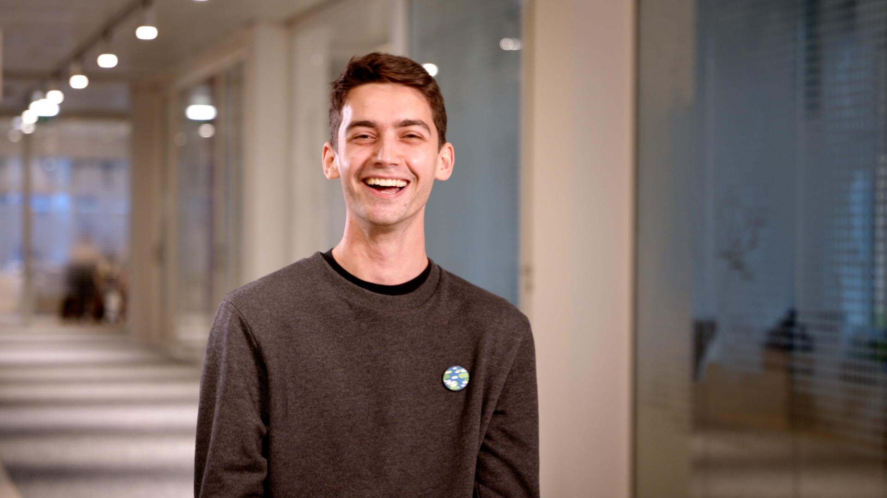
Notes:
Does anyone have any final questions?
Thank you for joining us, you’ve been a great group.
We look forward to reviewing your application.
Our next event is
(Women in Tech and Trading, Wed 16 March and Becoming an Optivarian – application tips and tricks on Friday 18 March)

